Slide 1
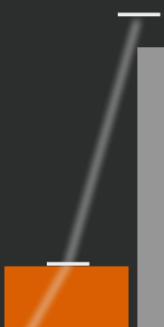
Drag the bars to move forward and backward in time
Small paths show the
direction to drag in
and the bar’s valid heights
Drag the orange bar above to try it!

Slide 2
When a bar doesn’t change height, follow
the wave by repeatedly dragging up and down
Drag the green bar above to try it!

Slide 3
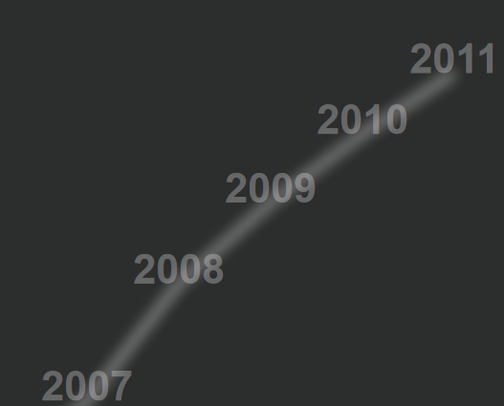
Click any year on the path
to go directly to that year

Slide 4

Bars with zero height
are still draggable
using the grey placeholder

Slide 6
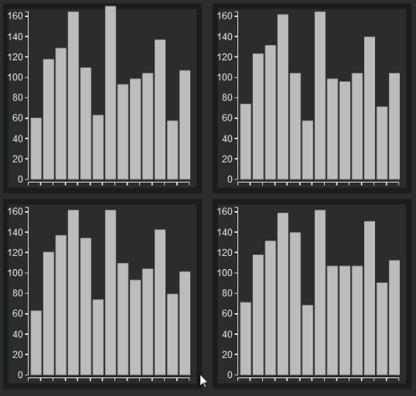
Views are arranged in time from left to right, then top to bottom
Time

Slide 7
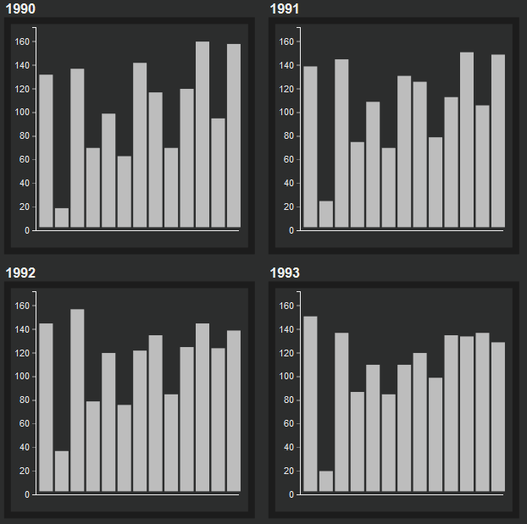
Views are arranged in time from left to right, then top to bottom
Time

